Slide 1
Coding Workshop

Slide 2
Outline
Raspberry Pi
Run Python on Pi
Circuit design
Programme the Gadgets
Mini Project - Smart Home

Slide 3
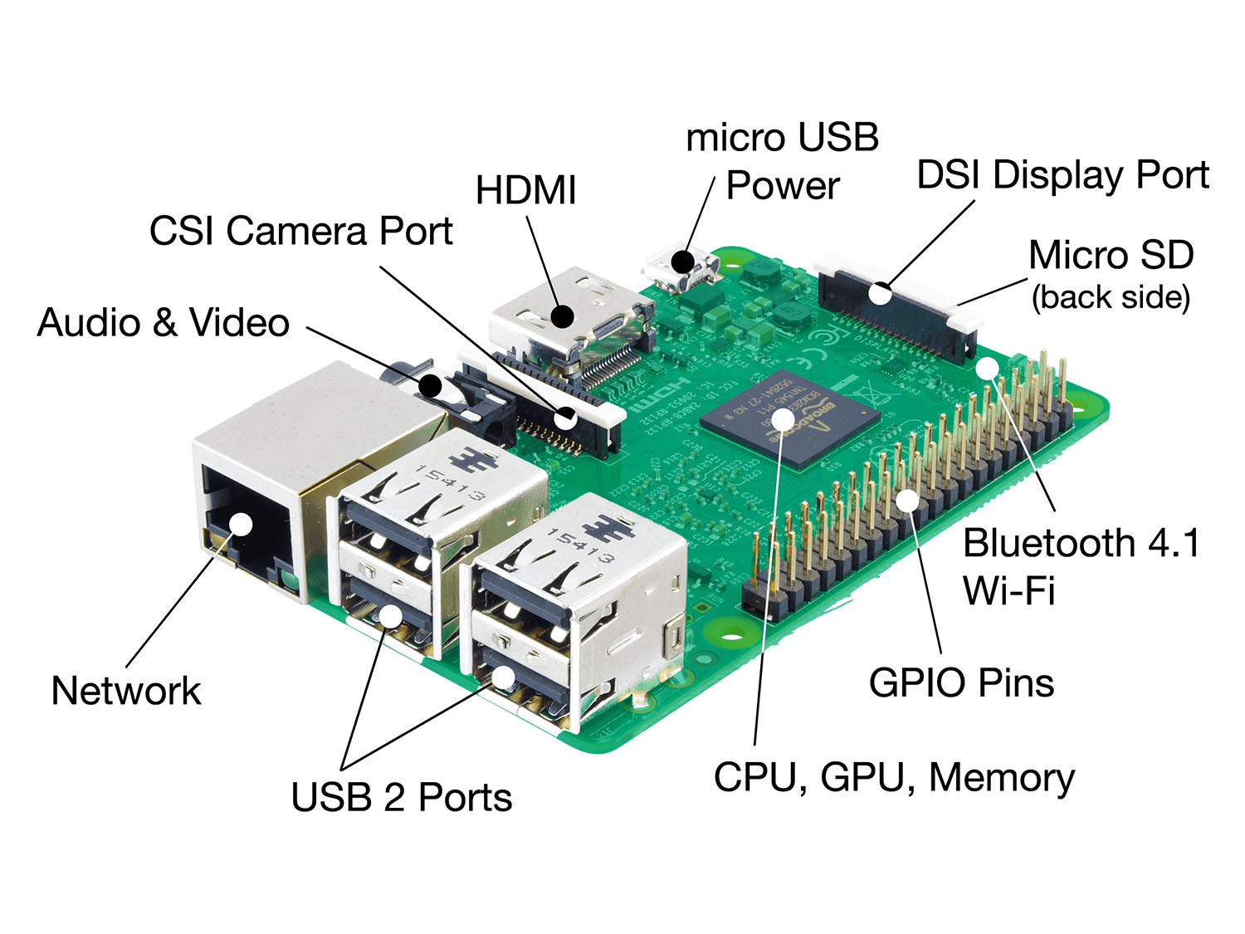
What is Raspberry Pi?
Notes:
https://www.raspberrypi.org/help/what-%20is-a-raspberry-pi/

Slide 4
“The Raspberry Pi is a credit-card sized computer..”
“able to interact with the outside world” => sensors, electronic gadgets
How does the interaction happen?
OS - SD card. Raspbian OS
I/O interface. GPIO

Slide 5
Python on Pi

Slide 6
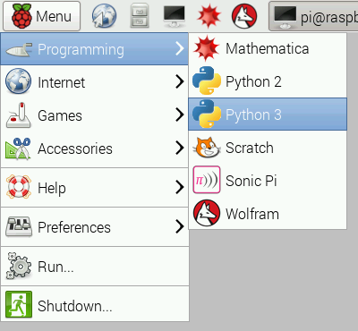
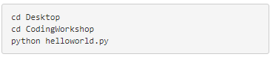
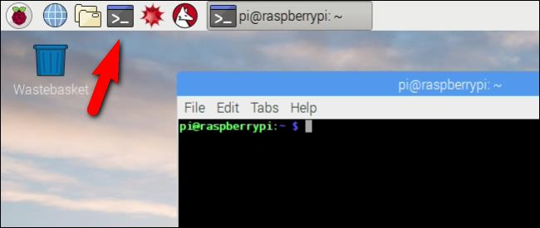
Python Programming on Pi
Notes:
Python Programming!
Write your first python program on the Pi!
Open a new Python program by opening the Python console and then clicking File> New.
Type in the below code: print(‘Hello World!’)
And save the file in the folder CodingWorkshop present on the Desktop as helloworld.py. To run this code, open the Raspberry-Pi Terminal and then run the following commands:
And there you have it, your first Python program on the Pi! :D

Slide 7
Circuit Design
Bread Board
Circuit Design Process
GPIO T-extension
Jumper wire

Slide 8
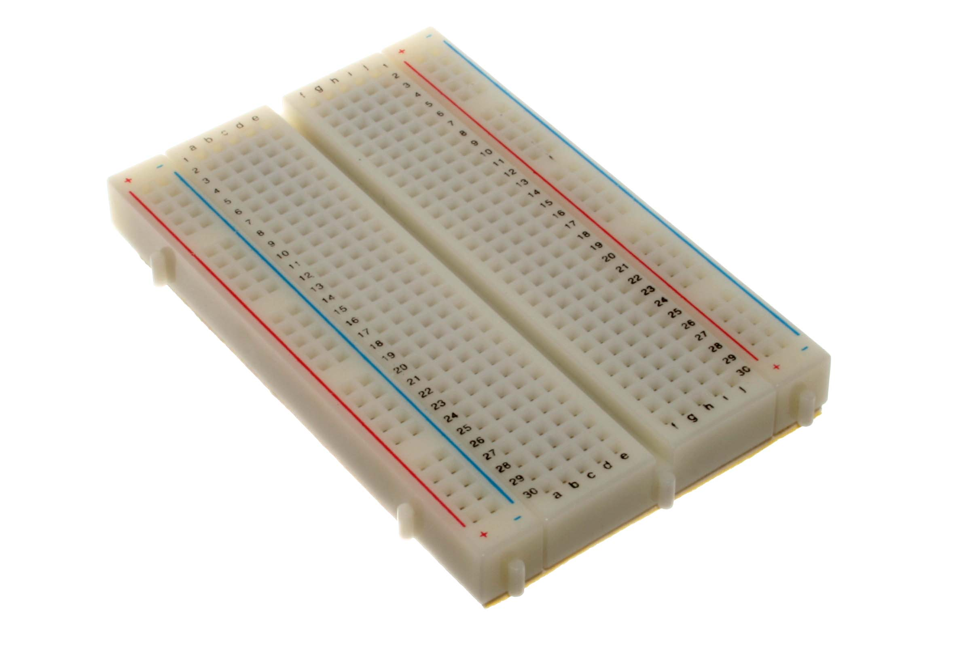
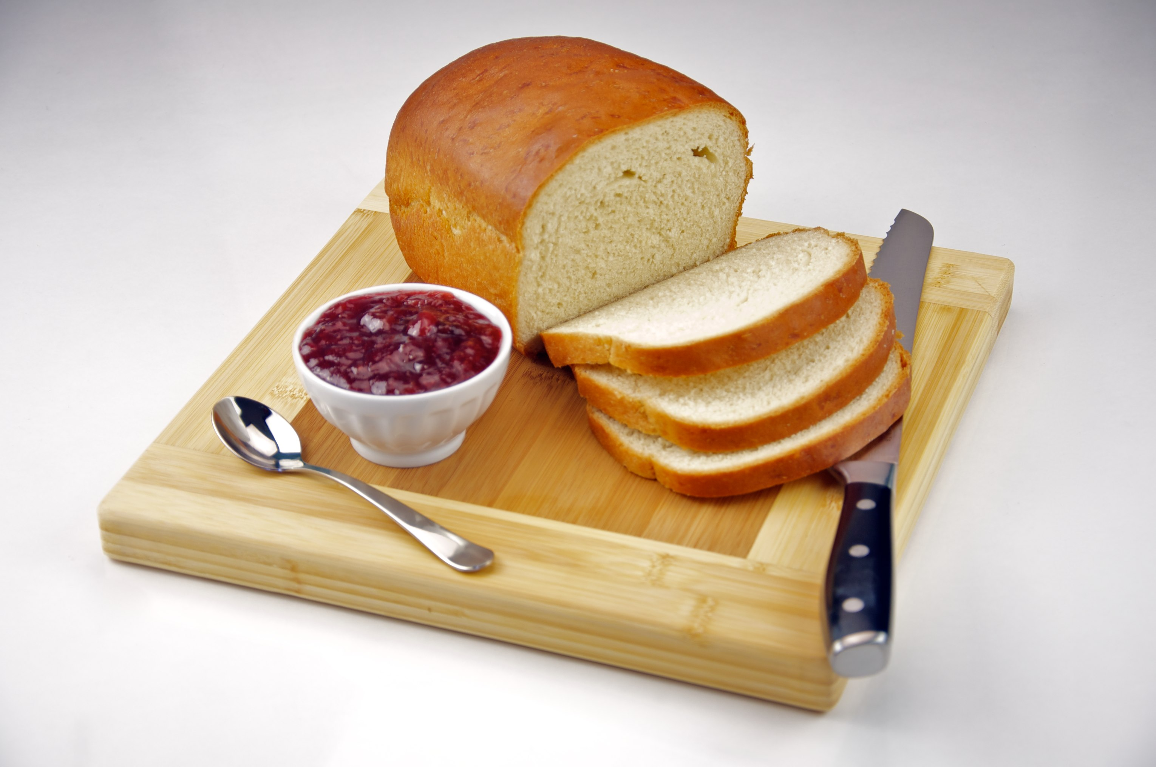
Bread Board?
Left: By oomlout - BREB-01 (Breadboard), CC BY-SA 2.0, https://commons.wikimedia.org/w/index.php?curid=19867043
Right: By Evan Swigart from Chicago, USA - Homemade White Bread with Strawberry Jam, CC BY 2.0, https://commons.wikimedia.org/w/index.php?curid=11626953

Slide 9
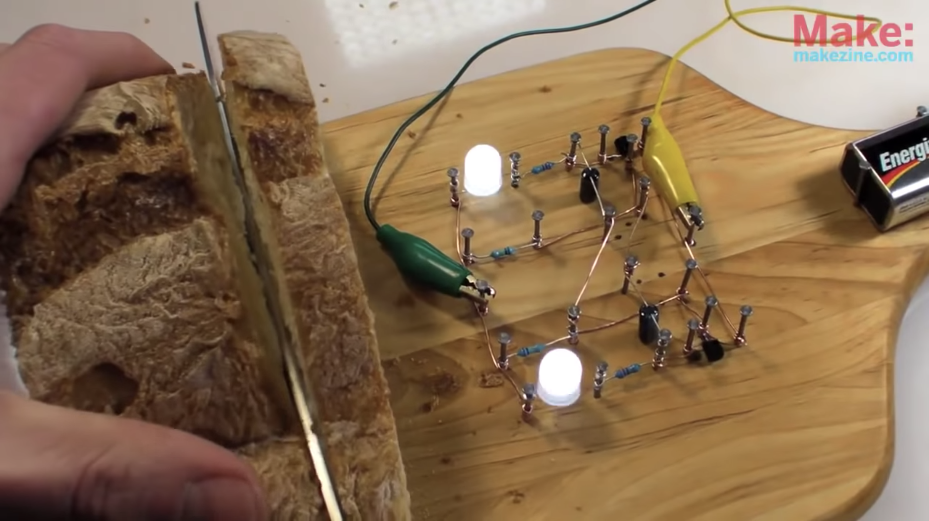
Bread Board
Collin's Lab: The REAL Breadboard, https://www.youtube.com/watch?v=HrG98HJ3Z6w&gl=SG&hl=en-GB

Slide 10
Solder-less Bread Board
By oomlout - BREB-01 (Breadboard), CC BY-SA 2.0, https://commons.wikimedia.org/w/index.php?curid=19867043

Slide 11
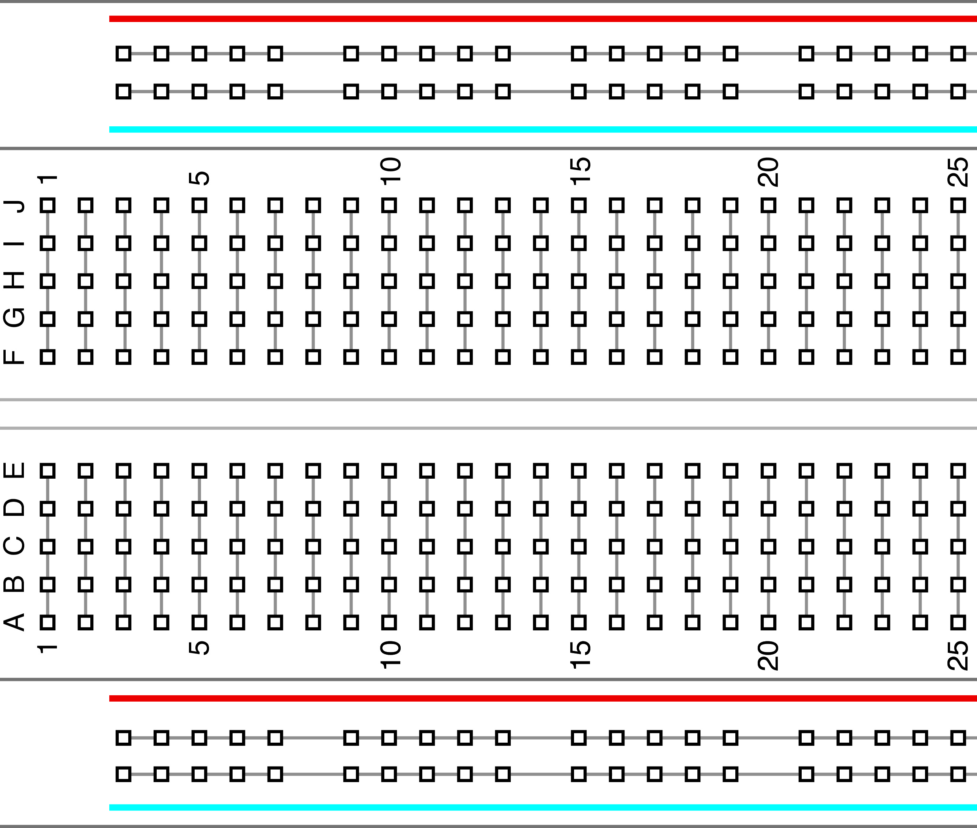
↙︎All the holes in this row are connected
↖︎All the holes in this row are connected
}
All the holes each column
are connected
}
All the holes each column
are connected
↙︎All the holes in this row are connected
↖︎All the holes in this row are connected
Notes:
Breadboard?
Just a board that has slots for easily connecting circuits and removing them. The black rows are connected as well as the blue and red columns.

Slide 12
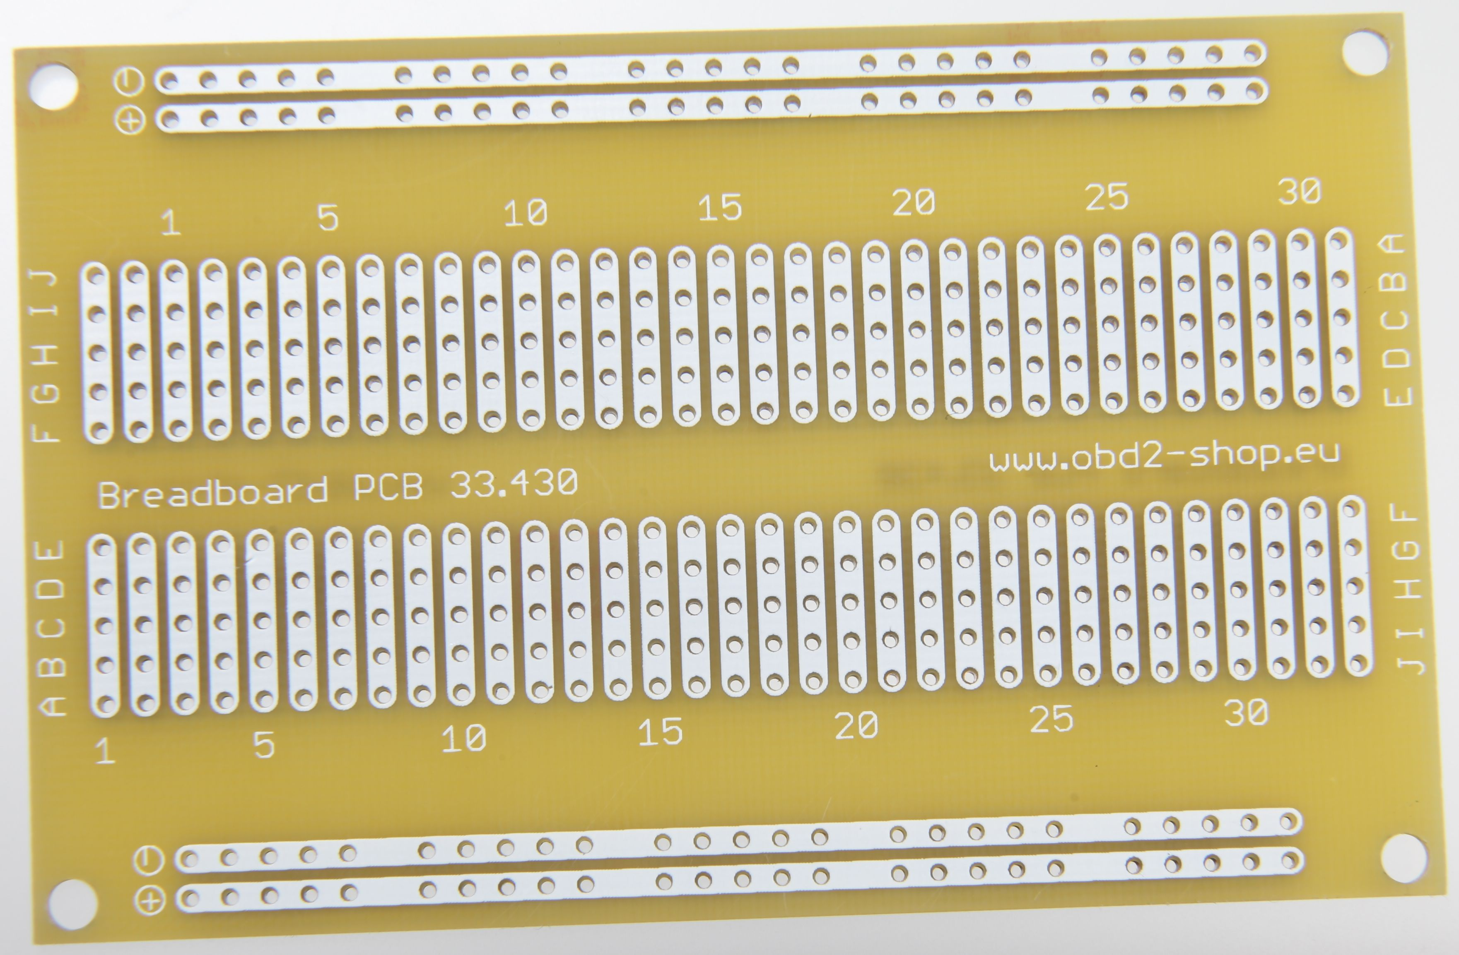
Printed Circuit Board
By Florian Schäffer - Own work, CC BY-SA 4.0, https://commons.wikimedia.org/w/index.php?curid=45535472

Slide 13
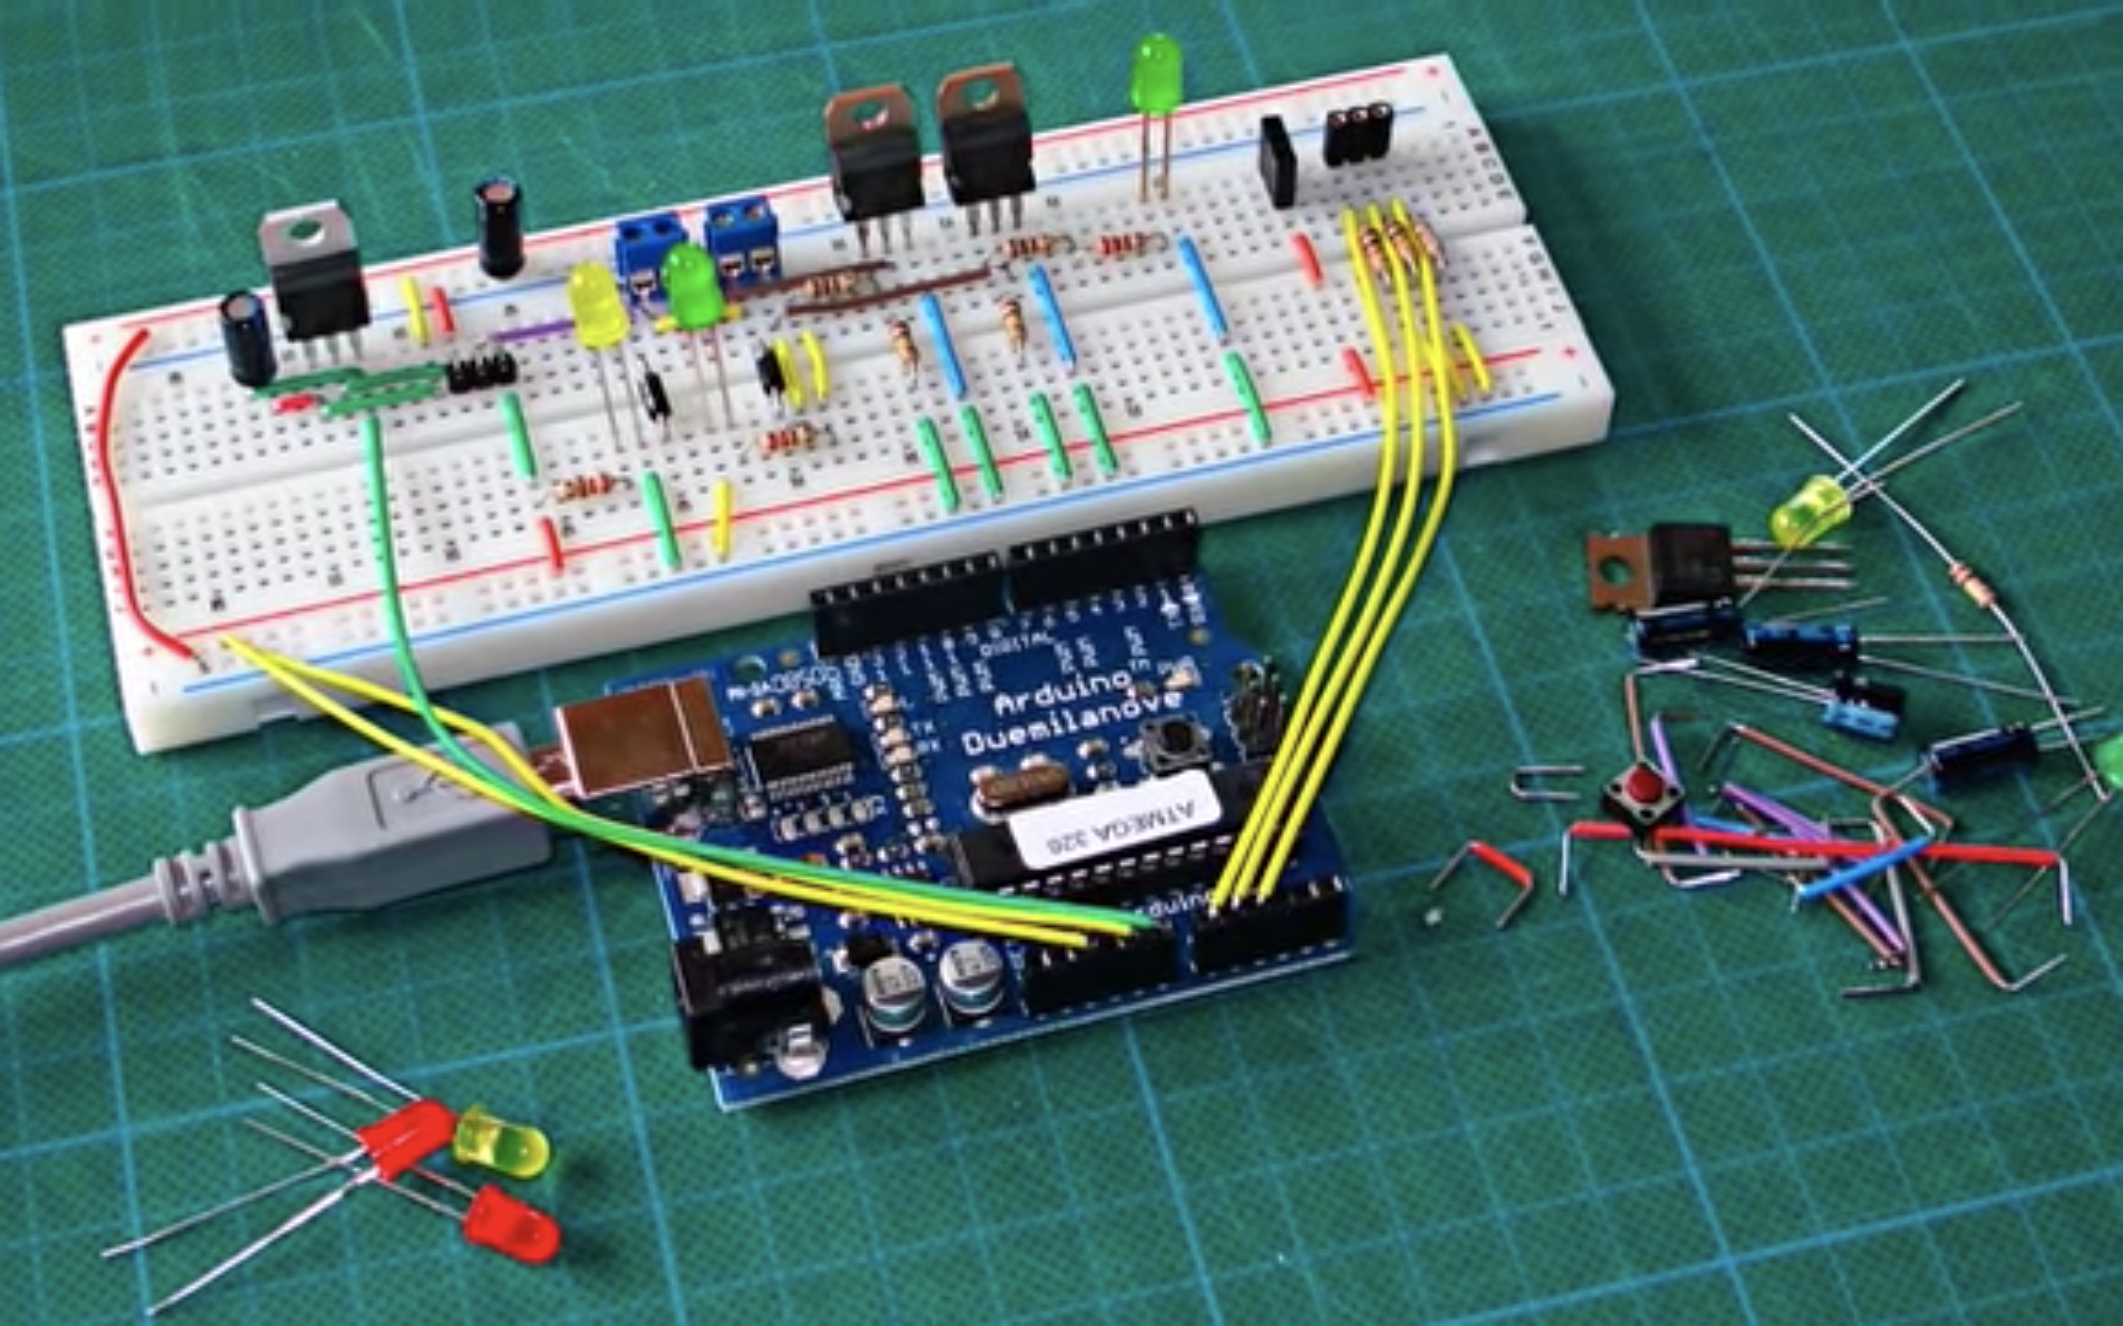
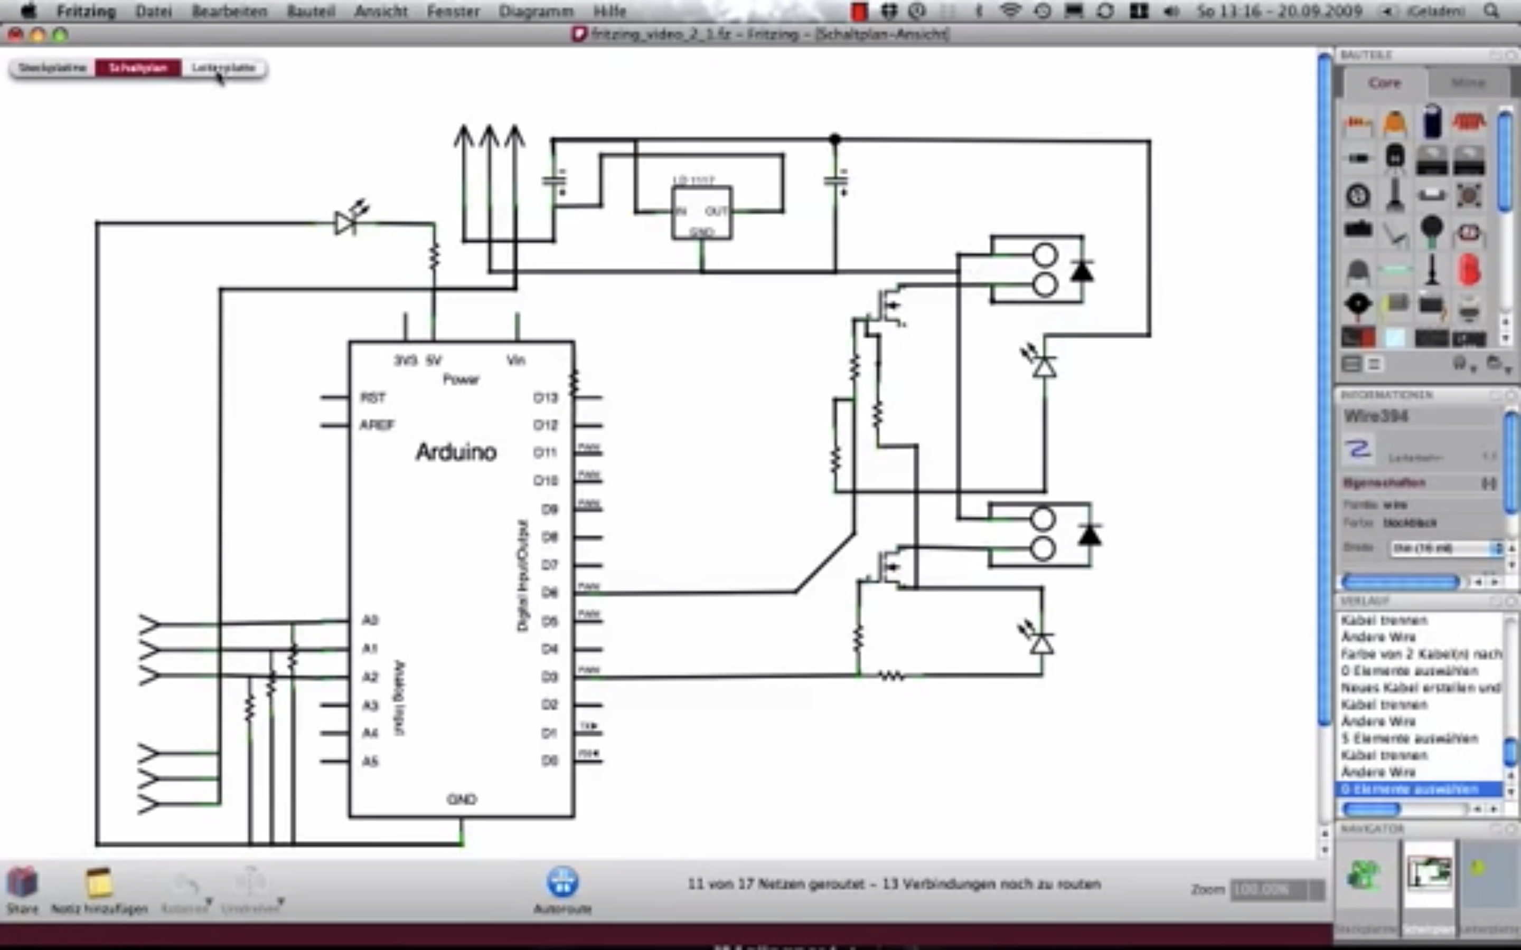
From Prototype to Commercial Electronics
By: http://fritzing.org/home/

Slide 14
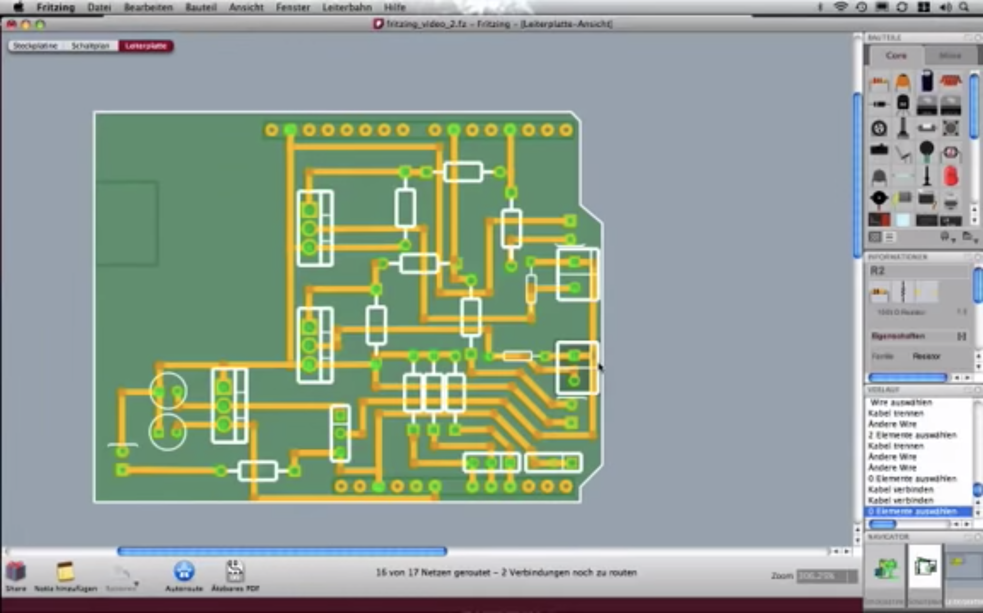
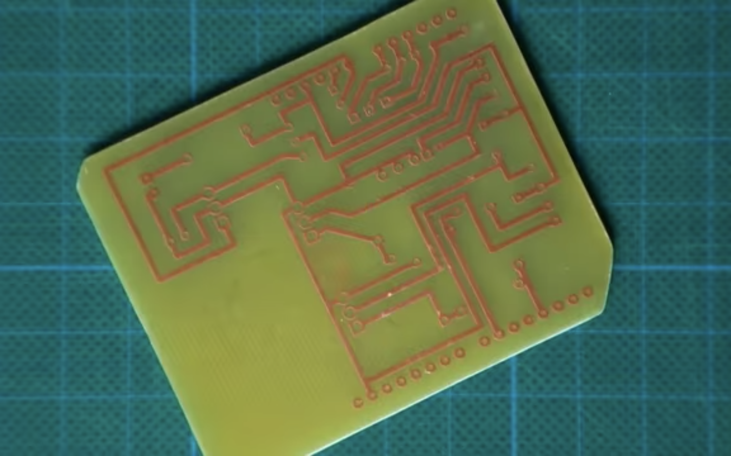
From Prototype to Commercial Electronics
By: http://fritzing.org/home/

Slide 15
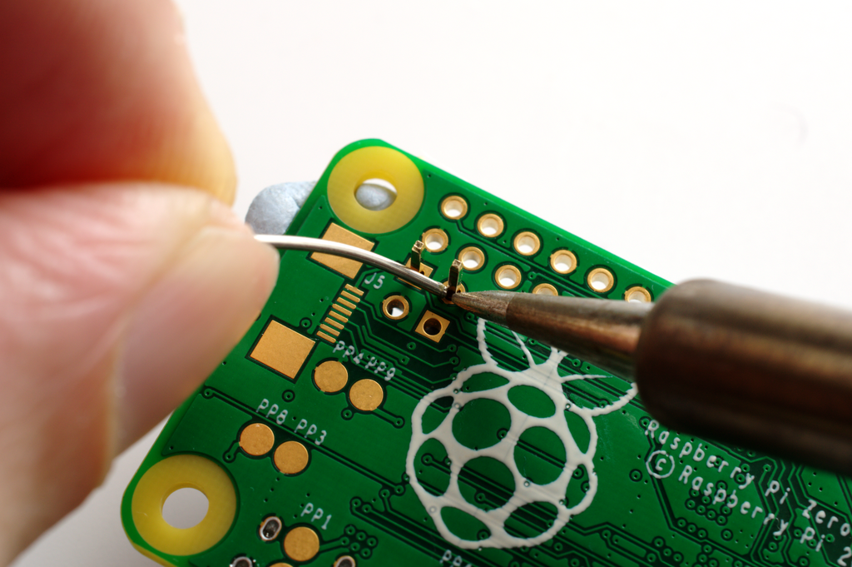
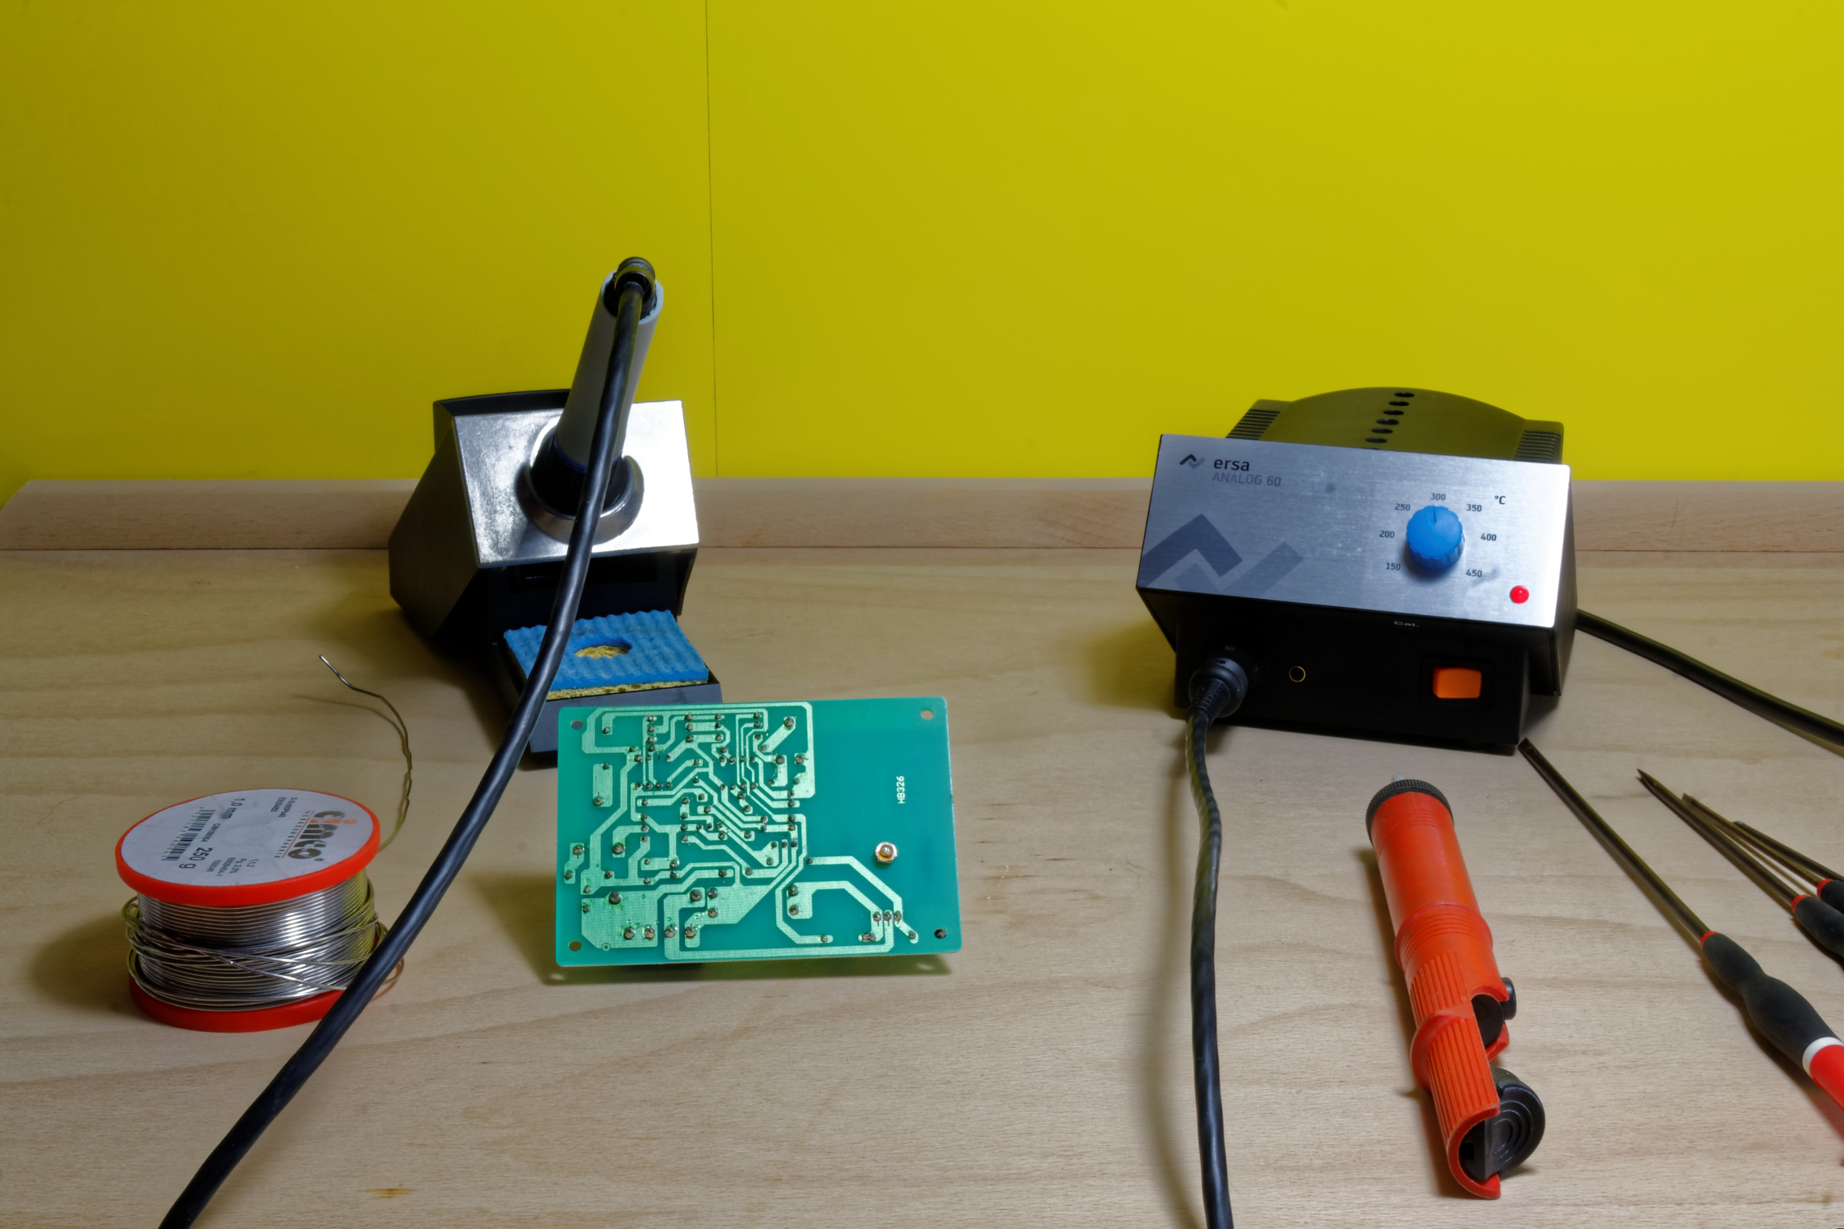
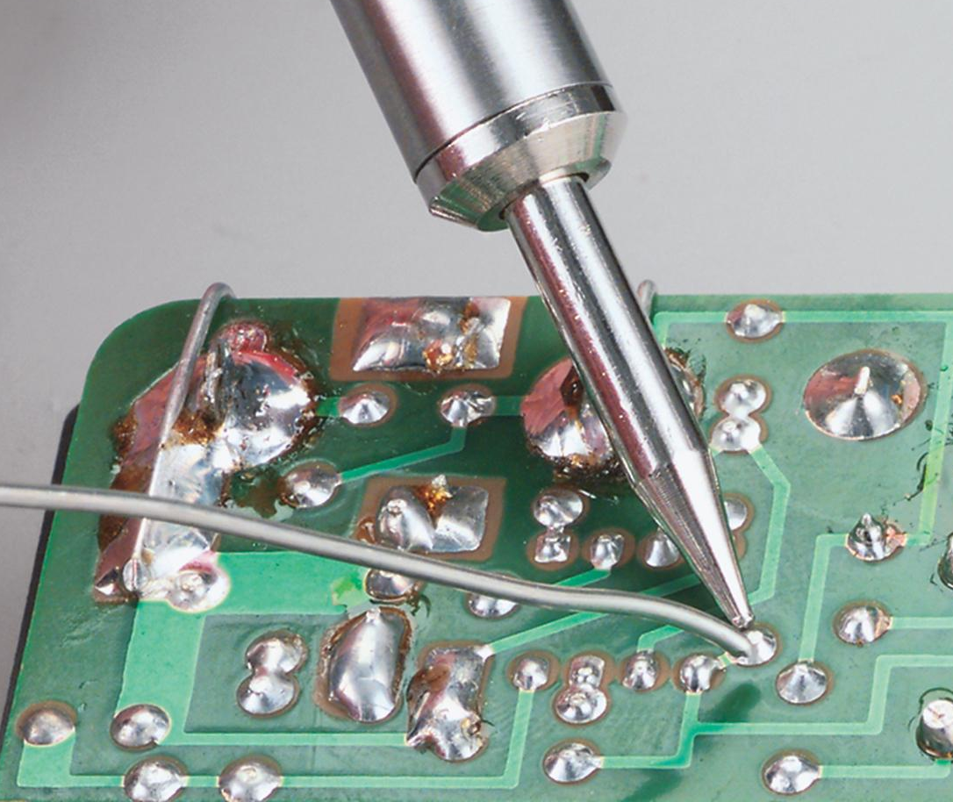
Top left: Gareth Halfacree from Bradford, UK [CC BY-SA 2.0 (https://creativecommons.org/licenses/by-sa/2.0)]
Botton left: https://m.media-amazon.com/images/S/aplus-media/vc/a40c0904-3a4c-427f-86cd-95a04a4bbf87.jpg
Right: https://pxhere.com/en/photo/1058819
Notes:
besides circuit design:
chip design
coding

Slide 16
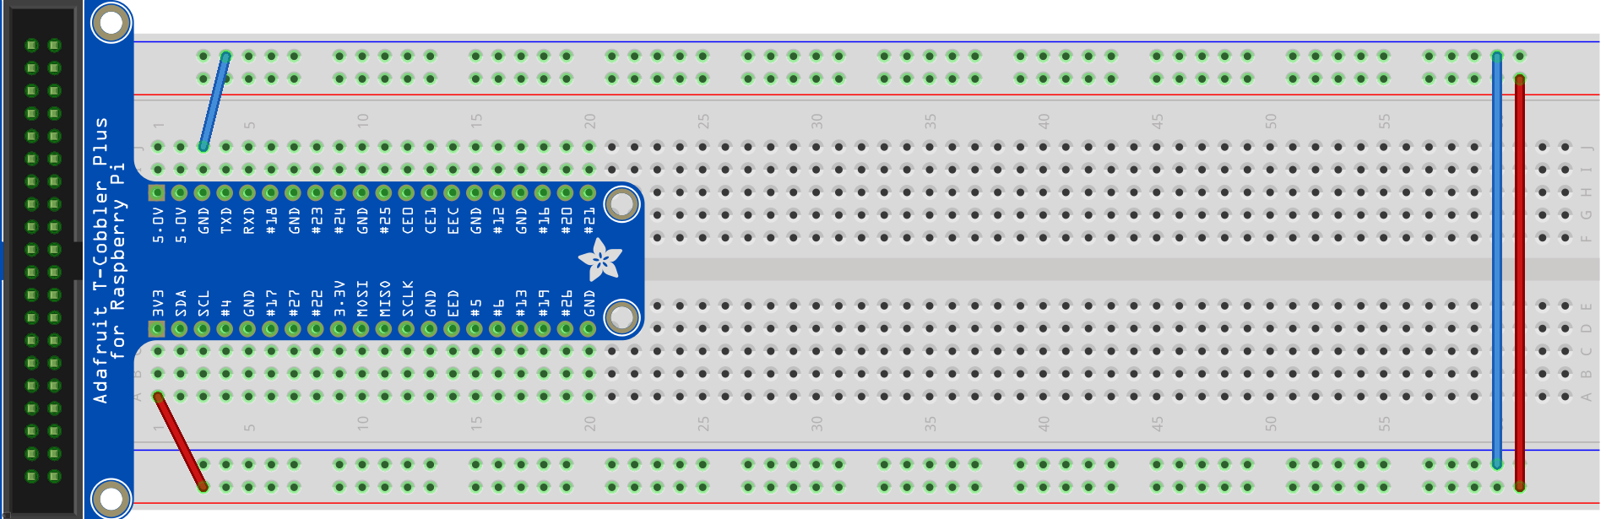
Initial Power Connection
Connect the 3.3V row to the red column and the GND to the blue column
Connect both blue columns and both red columns so that they are the same
Extra step for transparent breadboard: Connect the middle

Slide 17
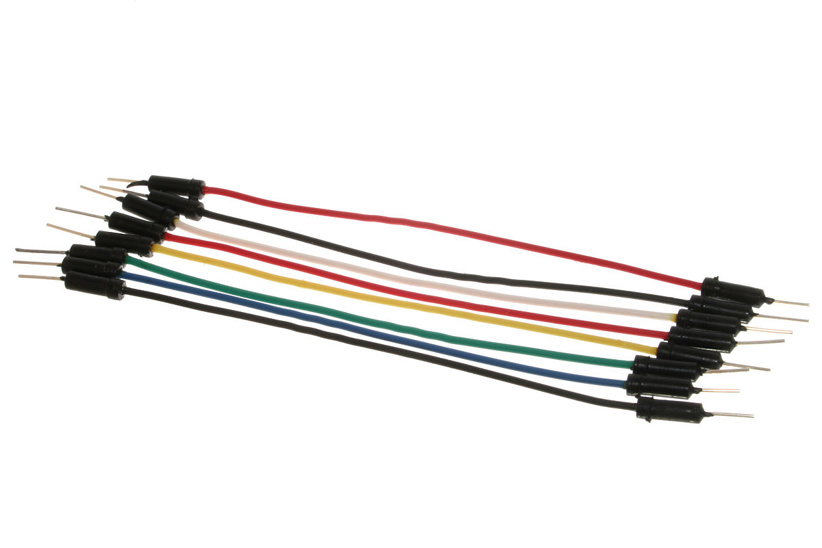
Jumper Wire
Top: By oomlout - A few Jumper Wires, CC BY-SA 2.0, https://commons.wikimedia.org/w/index.php?curid=19866418
Bottom: By oomlout - Jumper Wires with Crocodile Clips (x10) - JUMP-03Uploaded by bomazi, CC BY-SA 2.0, https://commons.wikimedia.org/w/index.php?curid=19866590

Slide 18
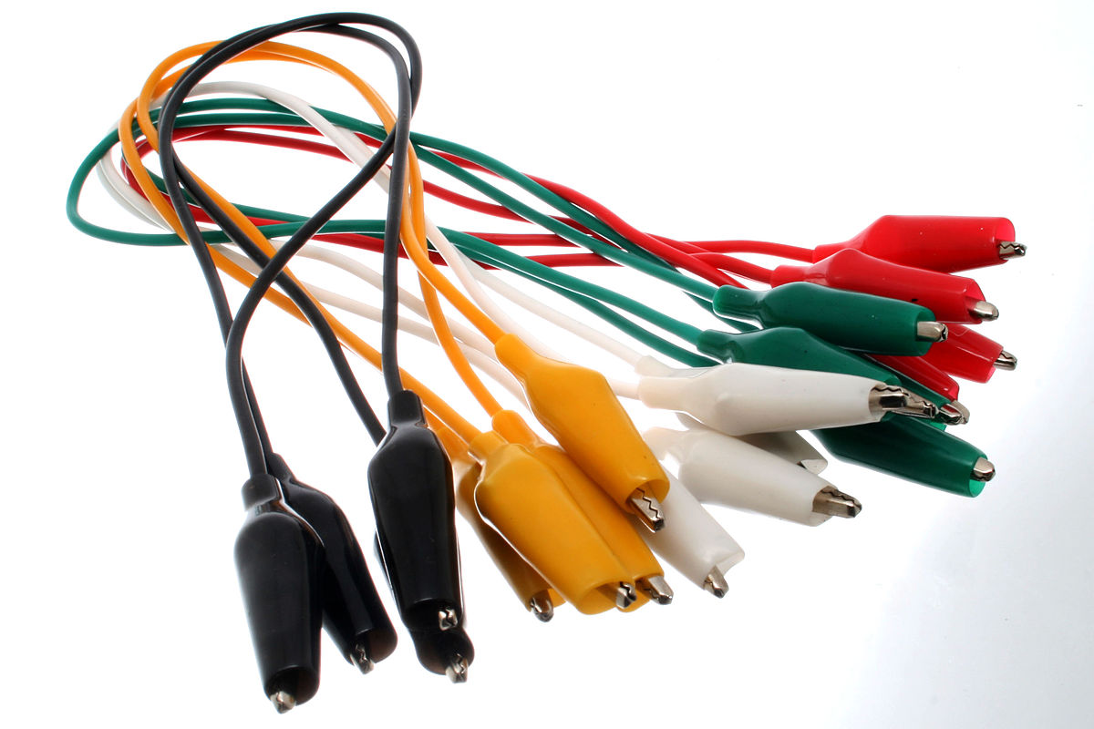
Jumper Wire
Top: By oomlout - A few Jumper Wires, CC BY-SA 2.0, https://commons.wikimedia.org/w/index.php?curid=19866418
Bottom: By oomlout - Jumper Wires with Crocodile Clips (x10) - JUMP-03Uploaded by bomazi, CC BY-SA 2.0, https://commons.wikimedia.org/w/index.php?curid=19866590

Slide 19
Gadgets
LED (Light-emitting Diode)
LDR (Light-dependant Resistor)
Switch
Buzzer [analog output]
7 Segment Display

Slide 20
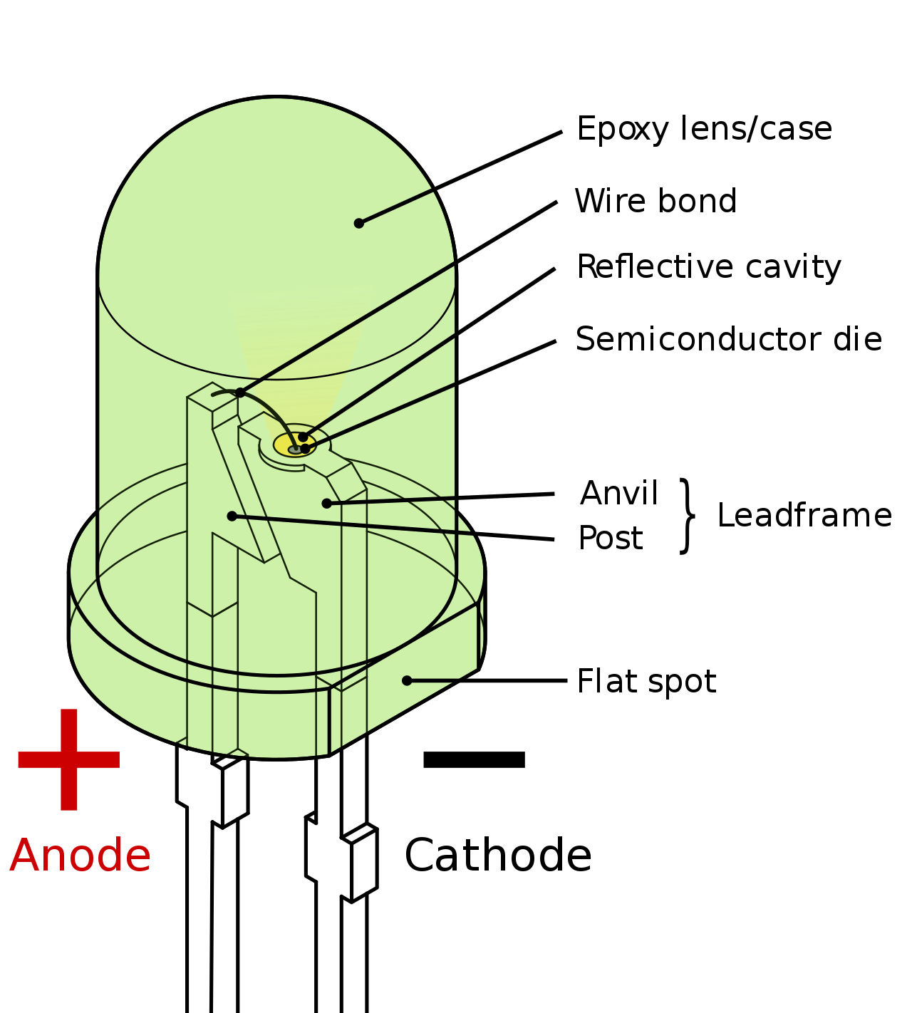
Light-emitting Diode
By Inductiveload - Own work by uploader, drawn in Solid Edge and Inkscape., Public Domain, https://commons.wikimedia.org/w/index.php?curid=6431789
Notes:
Diode
Pn junction
N-type p-type,
Power -> force holes and electrons to combine
Electron -> Drop in energy level -> release energy in the form of photon
The amount of energy determine frequency => the color of light
Another way of diff color : coat a layer/diff color of plastic wrapping -> cheaper

Slide 21
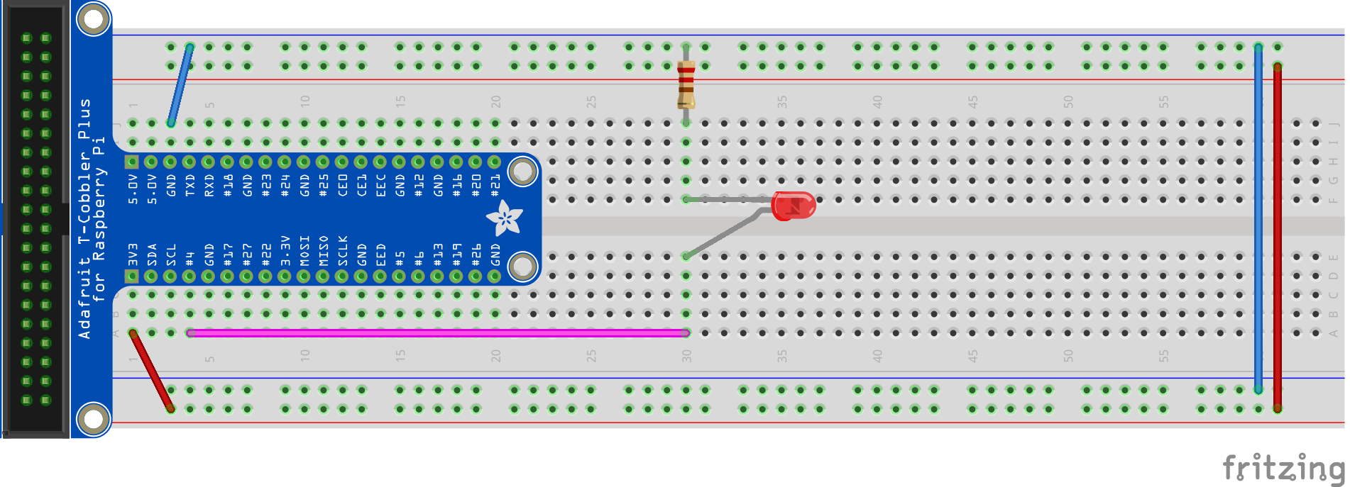
LED - Circuit
Resistor from ground to a row
Wire from pin #4 to a different row
LED connecting both the rows with the longer side connecting to pin #4

Slide 22
LED - Code
import RPi.GPIO as GPIO
import time
GPIO.setmode(GPIO.BCM)
GPIO.setwarnings(False)
GPIO.setup(4,GPIO.OUT)
print('LED on')
GPIO.output(4,GPIO.HIGH)
time.sleep(0.5)
print('LED off')
GPIO.output(4,GPIO.LOW)
time.sleep(0.5)

Slide 23

Make the LED blink 5 times
Make the LED blink at different frequency
Make different LEDs blink at different frequency
What are the resistance of our resistors?
Hint: Resistor Color Code
Notes:
https://www.digikey.sg/en/resources/conversion-calculators/conversion-calculator-resistor-color-code-4-band

Slide 24
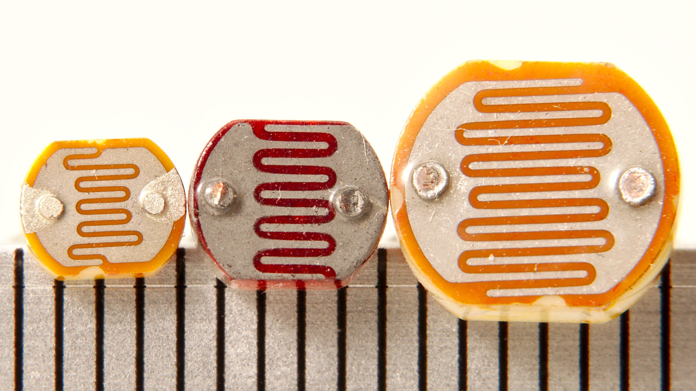
Light-dependent Resistor
x
By Junkyardsparkle - Own work, CC0, https://commons.wikimedia.org/w/index.php?curid=35977178
Notes:
Photo-resistor/Light-dependent resistor
Bright resistance (10Lux) (KΩ): 5 - 10
Dark resistance: 0.5 MΩ
(the negative side of the capacitor will be indicated by a stripe down the capacitor)
Semiconductor -> some free electrons move around to transmit electricity
Photons hits them -> electrons raise from valence band to conduction band
More electrons transmitting electricity -> smaller resistance

Slide 25
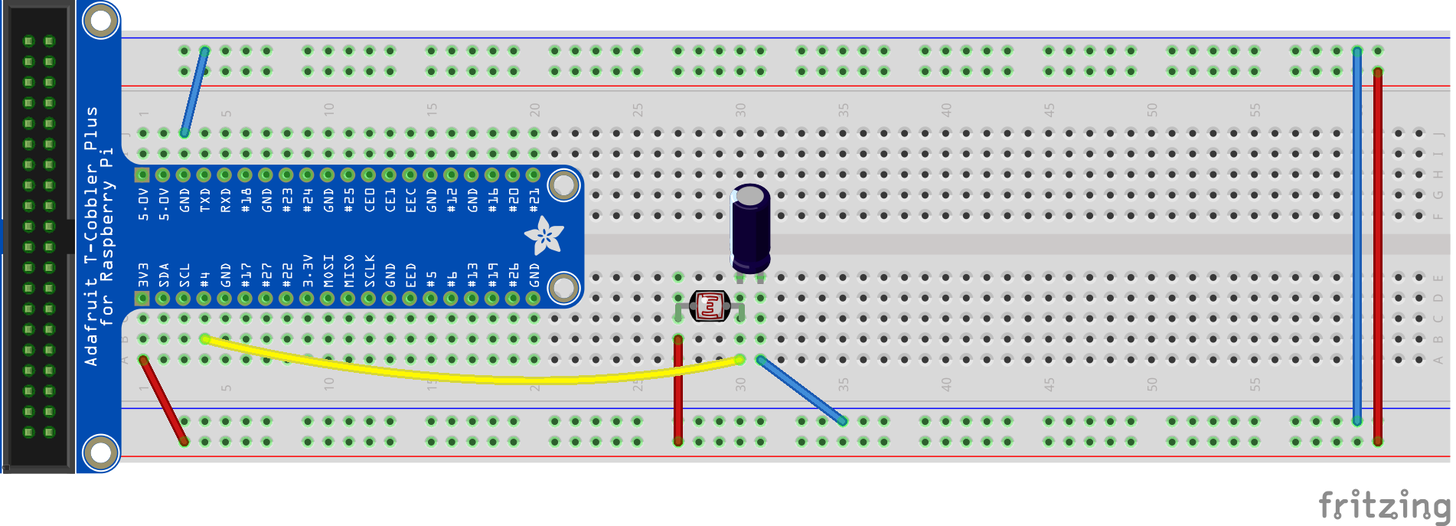
LDR - Circuit
Connect the negative side (shorter leg) of capacitor to ground
Connect positive side (longer leg) of capacitor to photo-esistor
Connect the other side of photoresistor to power

Slide 26
LDR - Code
from gpiozero import LightSensor
ldr = LightSensor(4)
while True:
print(ldr.value)

Slide 27
LDR - hard version
import RPi.GPIO as GPIO
import time
GPIO.setmode(GPIO.BCM)
GPIO.setwarnings(False)
def RCtime (RCpin):
reading = 0
GPIO.setup(RCpin, GPIO.OUT)
GPIO.output(RCpin, GPIO.LOW)
time.sleep(0.1)
GPIO.setup(RCpin, GPIO.IN)
# This takes about 1 millisecond per loop cycle
while (GPIO.input(RCpin) == GPIO.LOW):
reading += 1
return reading
while True:
print(RCtime(4)) # Read RC timing using pin #4

Slide 28
Use the reading to control LED
Use the reading to control different LEDs

Slide 29
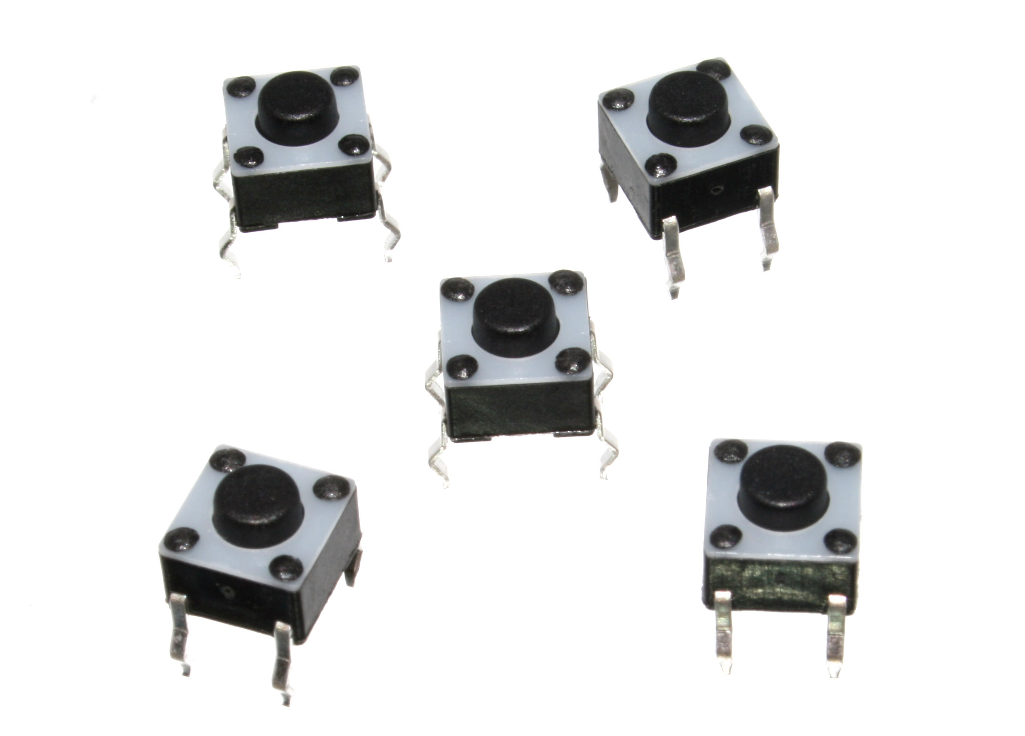
Switch
x
By oomlout - BUTT-01 (Pushbuttons), CC BY-SA 2.0, https://commons.wikimedia.org/w/index.php?curid=23281155

Slide 30
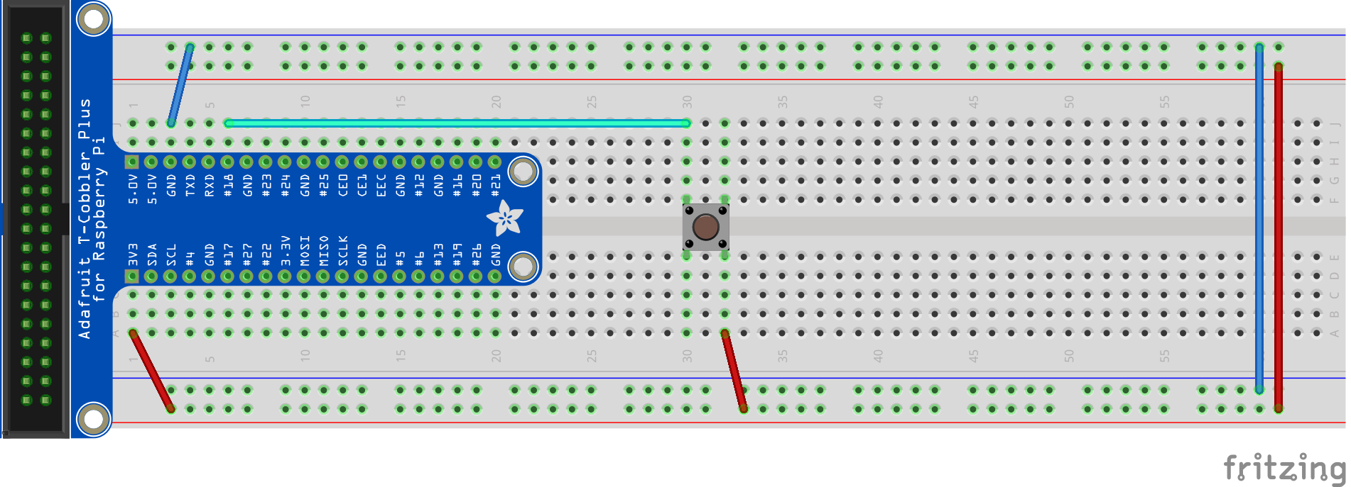
Switch - Circuit
Plug in switch in the middle
Wire from 3.3V (red line) to a row
Wire from pin #18 to a different row
Notes:
http://razzpisampler.oreilly.com/ch07.html

Slide 31
Switch - Code
import RPi.GPIO as GPIO
import time
GPIO.setmode(GPIO.BCM)
GPIO.setwarnings(False)
PORT_IN = 18
GPIO.setup(PORT_IN, GPIO.IN, pull_up_down=GPIO.PUD_DOWN)
while True:
input_state = GPIO.input(PORT_IN)
if input_state == 1:
print('Button Pressed')
time.sleep(0.2)

Slide 32
Count the number of times the button is pressed and print out on console
If we change code to: pull_up_down=GPIO.PUD_UP, how should we change the circuit accordingly?
Switch on the LED when the button is pressed

Slide 33
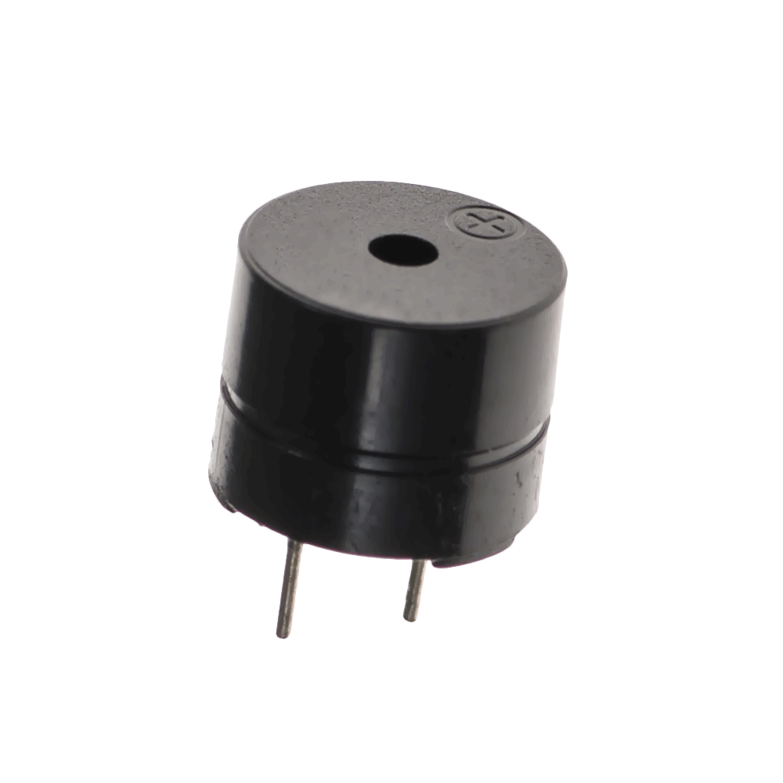
Buzzer

Slide 34
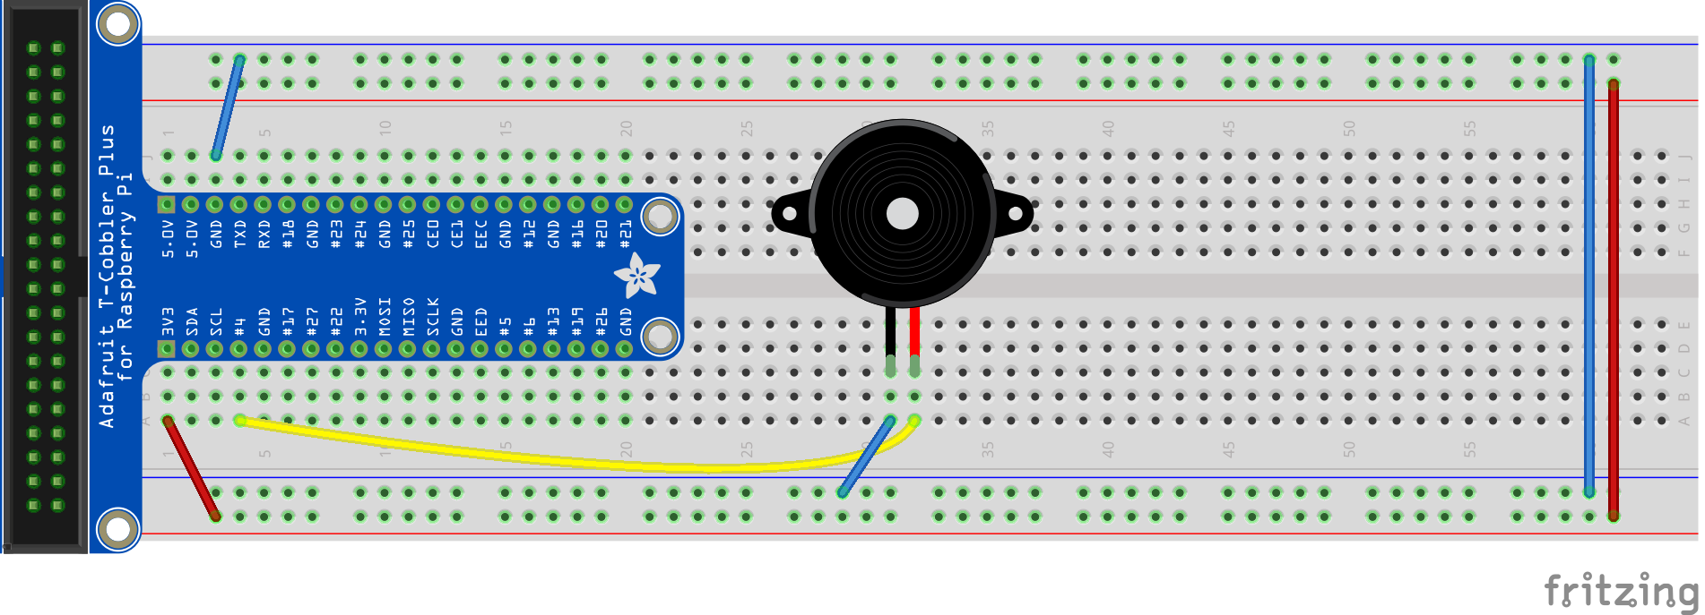
Buzzer - Circuit
Wire from #4 to longer leg
Wire from ground to shorter leg

Slide 35
Make some noise

Slide 36
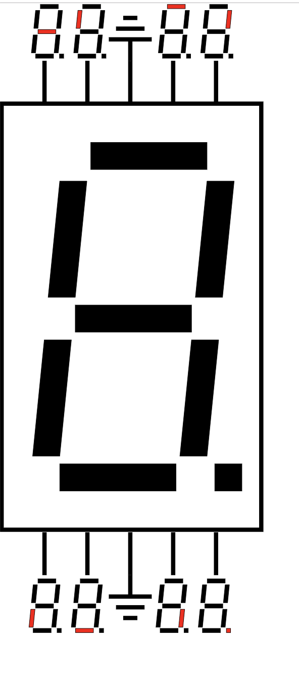
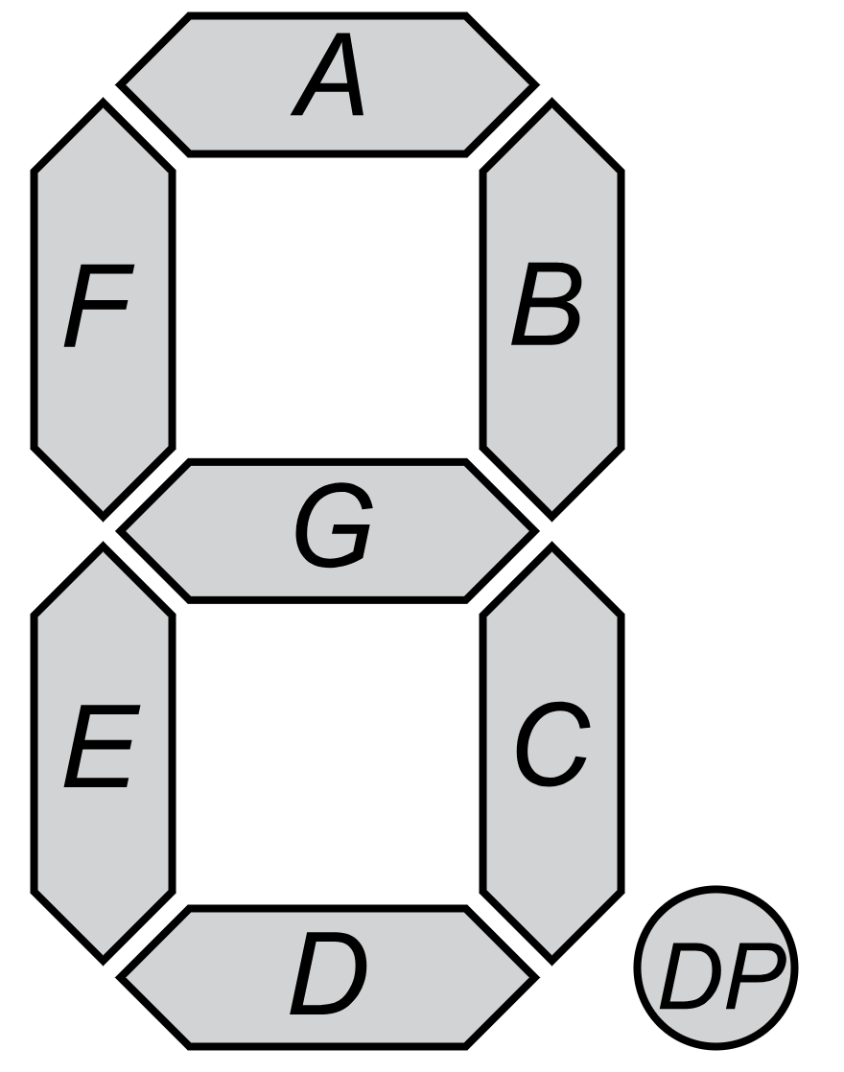
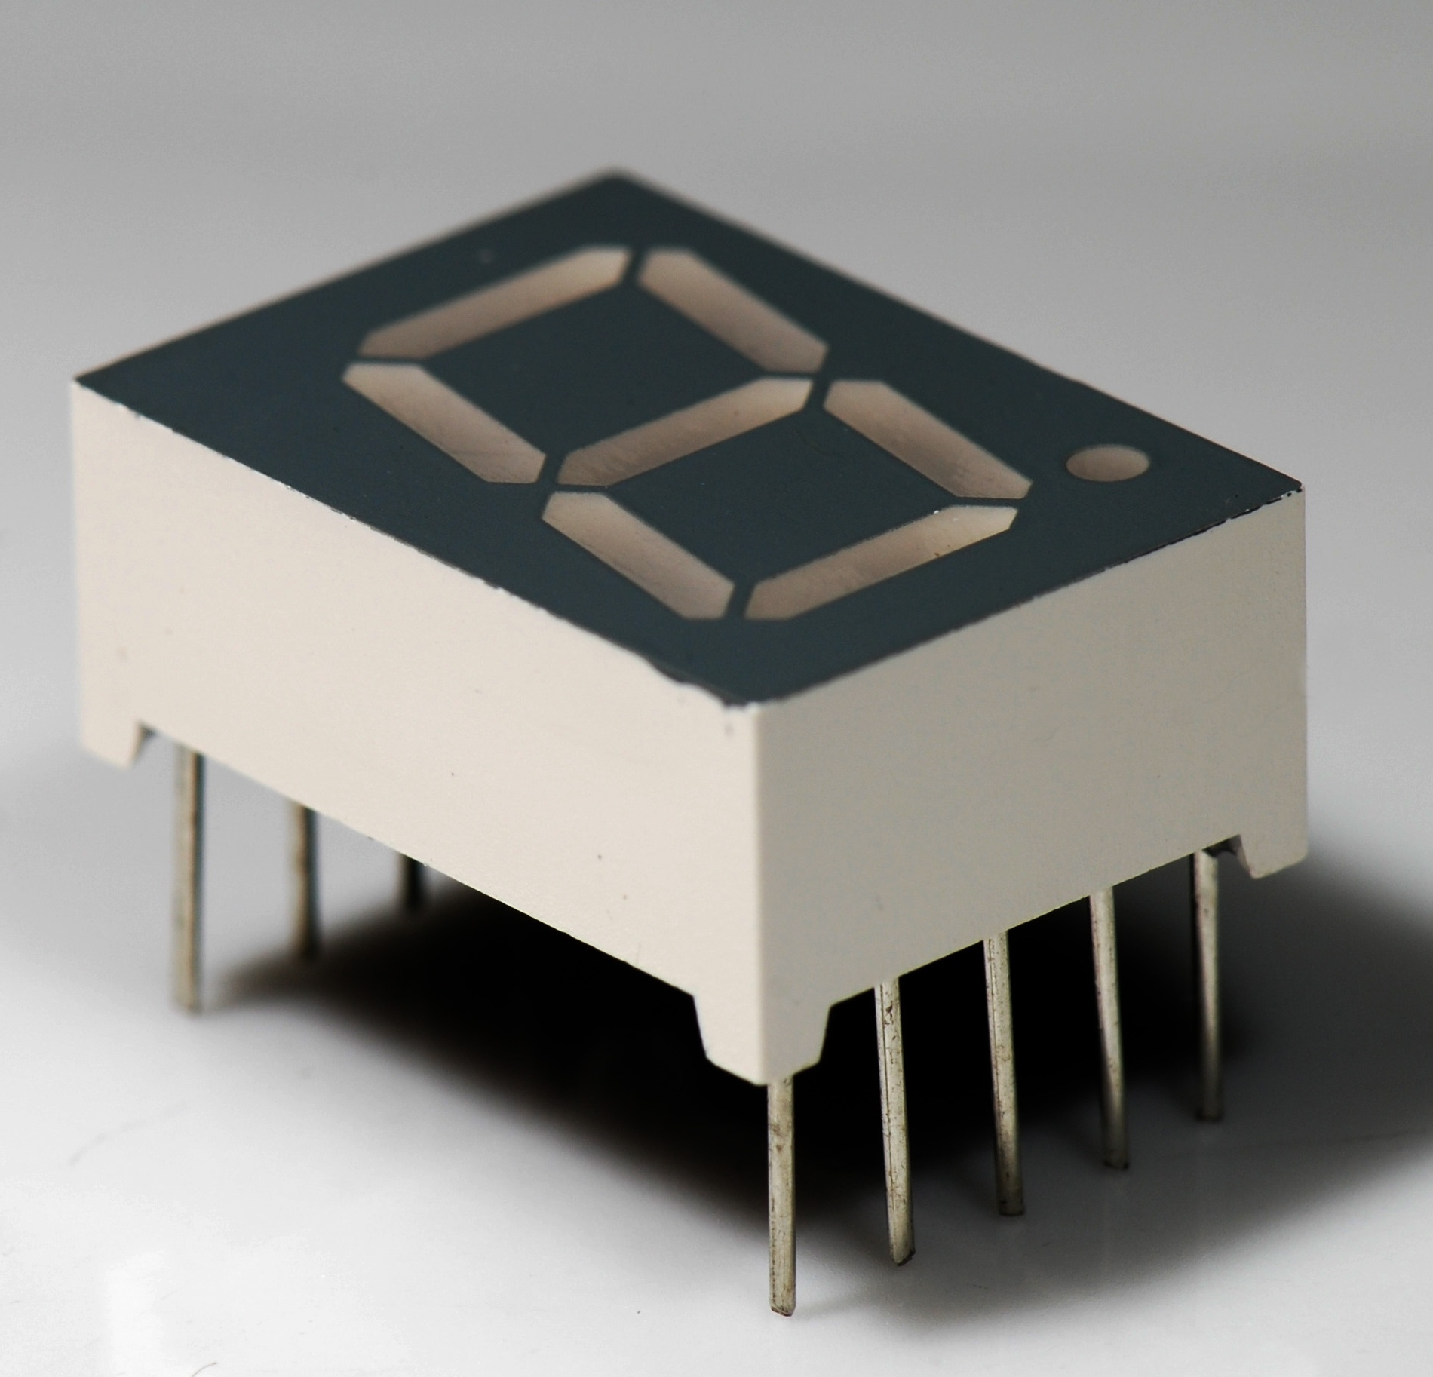
7 Segment
CC BY-SA 3.0, https://commons.wikimedia.org/w/index.php?curid=2550283
By Avh.on1 - Own work, CC0, https://commons.wikimedia.org/w/index.php?curid=48765863
By Uln2003 - Own work, CC0, https://commons.wikimedia.org/w/index.php?curid=69807877

Slide 37
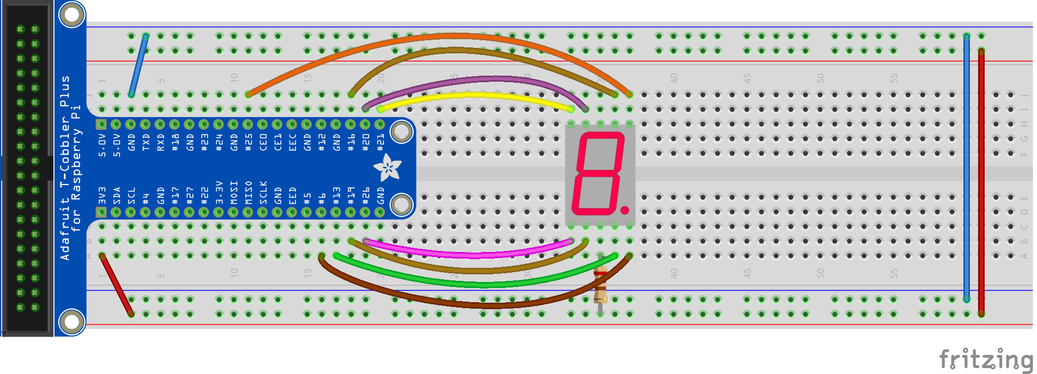
7 Segment - Circuit
Connect the middle bottom pin to the 3.3V + power line via a resistor
Connect the other 8 side pins to any free pins on the raspberry pi
Notes:
Circuit Connections:
- Connect the middle bottom pin to the 3.3V + power line via a resistor - Connect the other 8 side pins to any free pins on the raspberry pi
Python Code:
1. Fix display.py
Open the display.py file found in the CodingWorkshop folder.
Fix the values for a-h depending on which pins you connected them to.
Edit the values in the matrix num depending on the number to be displayed.

Slide 38
7 Segment - Code
1. Fix display.py
Open the display.py file in the CodingWorkshop folder.
Fix the values for a-h depending on which pins you connected them to.
Edit the values in the matrix num depending on the number to be displayed.
2. Code to display a digit - sevenSeg.py
import RPi.GPIO as GPIO
import time
from display import display
GPIO.setmode(GPIO.BCM)
GPIO.setwarnings(False)
GPIO.cleanup()
display(0)

Slide 39
Displace number increasingly/decreasingly
Count the number of times the button is pressed and display on 7-seg

Slide 40
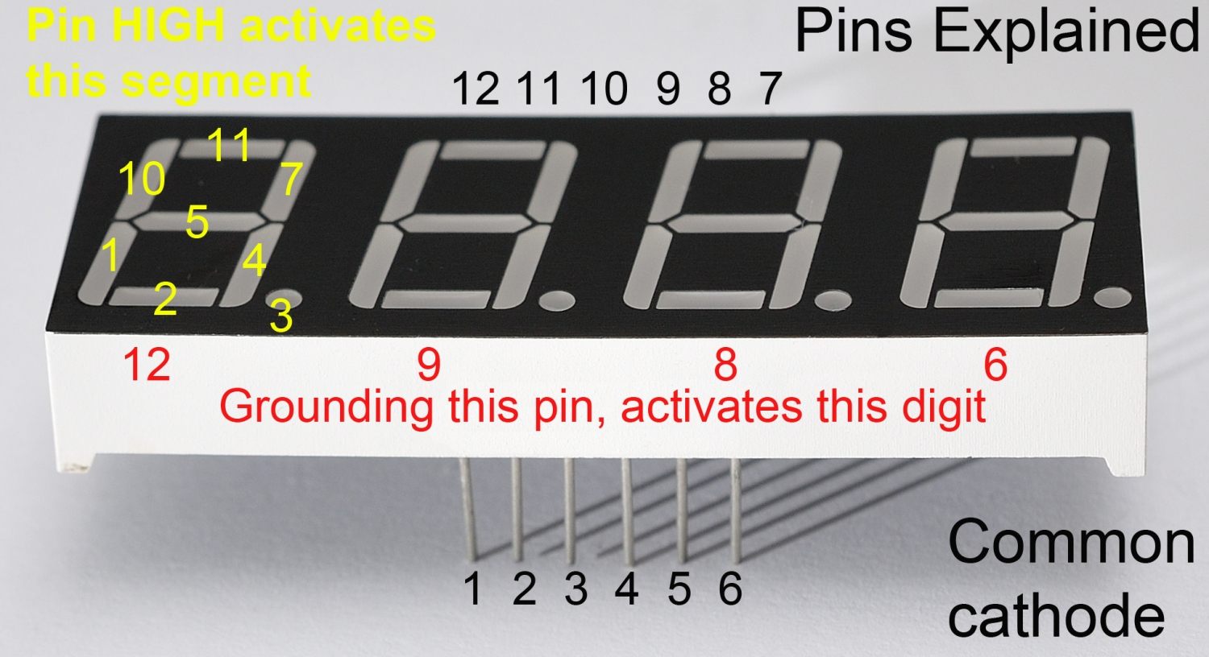
4 Digit 7-Seg
x
https://raspi.tv/2015/how-to-drive-a-7-segment-display-directly-on-raspberry-pi-in-python

Slide 41
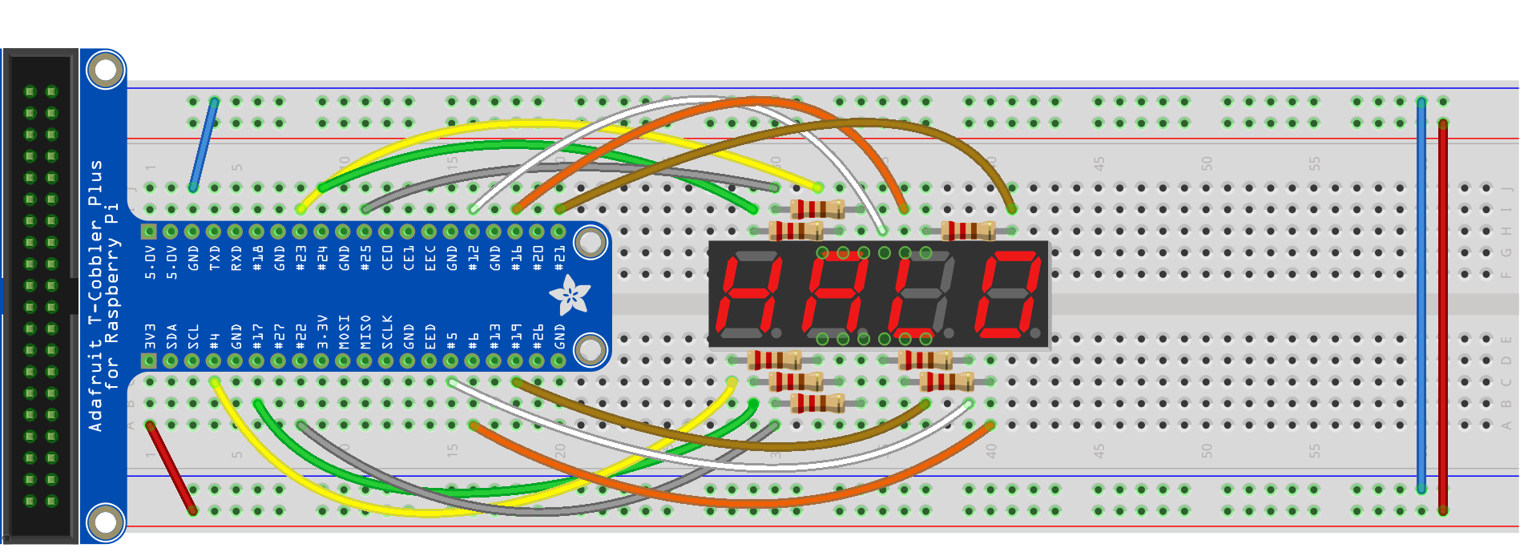
4Digit 7Seg - Circuit

Slide 42
4 Digit 7 Seg - Circuit
Seg / digit | 7Seg Pin | Resistor | BCM GPIO #
Bot left | 1 | Y | 4
Bot centre | 2 | Y | 17
Decimal pt | 3 | Y | 22
Bot right | 4 | Y | 5
Centre centre | 5 | Y | 6
Digit 4 | 6 | N | 19
Top right | 7 | Y | 21
Digit 3 | 8 | N | 16
Digit 2 | 9 | N | 12
Top left | 10 | Y | 25
Top centre | 11 | Y | 24
Digit 1 | 12 | N | 23

Slide 43
Display 4 different numbers at the same time
Make a clock with minutes and seconds

Slide 44
Project -
Smart Home Application

Slide 45
Example
Example system design:
Morning alarm system: alarm rings at 8AM, push alarm button to stop the alarm, and then light turns on automatically
Buzzer rings when 7seg goes to 8, push button to stop the alarm, and the LED lights up automatically

Slide 46
Project
https://lets-code-p.github.io/ => Gallery
Photo of the project
Short description of the project

Slide 47
Resources
https://projects.raspberrypi.org/en/projects/raspberry-pi-getting-started
https://curriculum.raspberrypi.org/
http://fritzing.org/home/ fritzing: a software to document prototypes, and help to translate into schematics
https://github.com/adafruit/Fritzing-Library
Resistor color code: https://www.digikey.sg/en/resources/conversion-calculators/conversion-calculator-resistor-color-code-4-band https://
romannurik.github.io/SlidesCodeHighlighter/
Notes:
https://www.sgbotic.com/
https://www.robot-r-us.com

